Slide 1

Class 8 – Support Vector Machines (SVM) Classification
Pedram Jahangiry
Fall 2019
Notes:
It’s kind of classification model that a computer scientist would approach.
There is no probability assigned
One of the best classification models
Introduced in 1960 and got reconsidered in 1990 and now in >2015 very popular in ML.
SVM is supervised ML
SVM is a non-probabilistic binary linear classifier.

Slide 2
Support Vector Machines
Here we approach the two-class classification problem in a direct way:
We try to find a plane that separates the classes in feature space.
If we cannot, we get creative in two ways:
We soften what we mean by “separates”, and
We enrich and enlarge the feature space so that separation is possible.

Slide 3
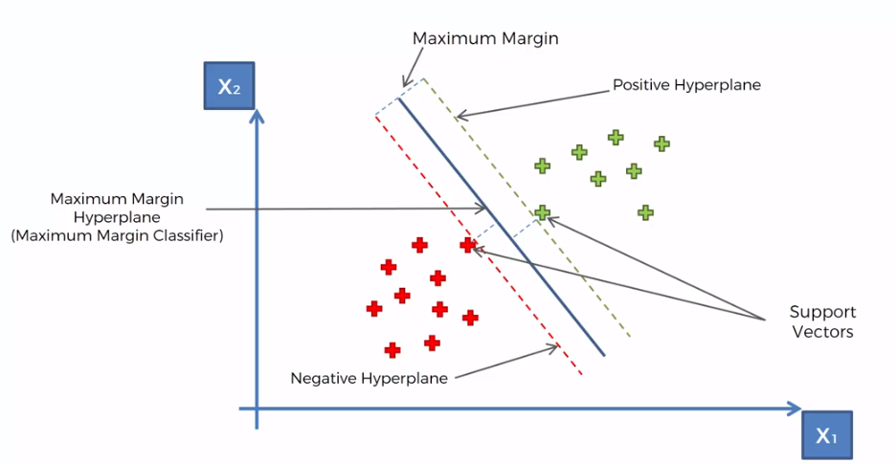
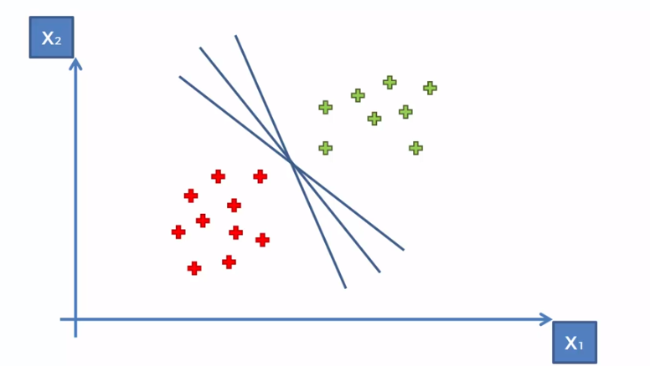
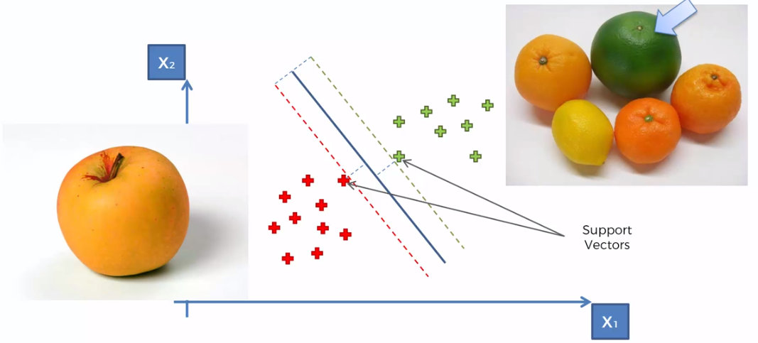
Separable data
Notes:
Very common mistake: only support points will contribute to the algorithms. This is absolutely WRONG!

Slide 4
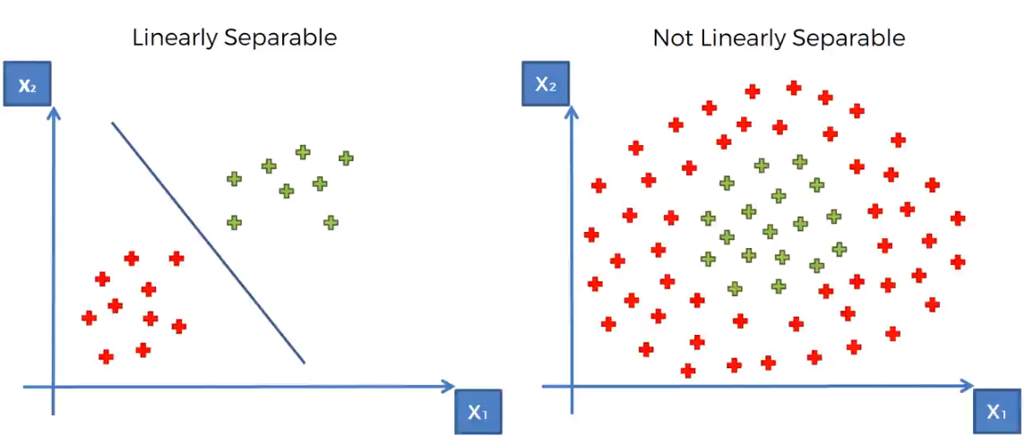
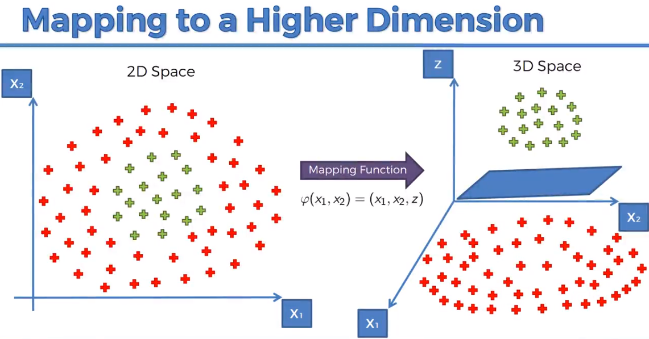
Non-Linearly Separable data
Notes:
Start with the example of one dimension where the data is not separable. Doing some tricks: f= x-5 and then f^2 and then show it is separable. So the data is separable in 2 dimensions.
The same story for non separable in 2 dimensions but separable in 3.

Slide 5
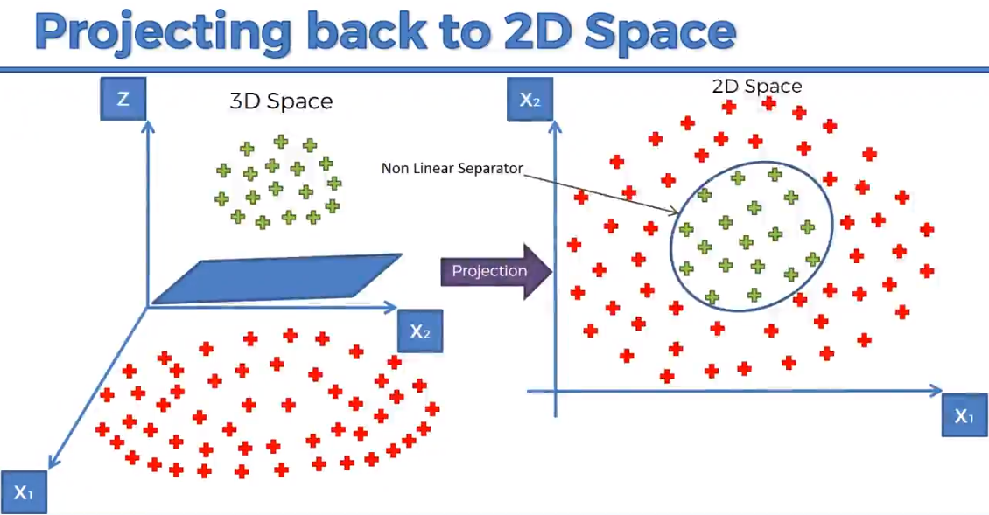
Non-Linearly Separable data (cont’d)
Notes:
Start with the example of one dimension where the data is not separable. Doing some tricks: f= x-5 and then f^2 and then show it is separable. So the data is separable in 2 dimensions.
The same story for non separable in 2 dimensions but separable in 3.
Caveat! Mapping to higher dimensional space can be highly compute-intensive. So that’s why we are going to use Kernel Trick.

Slide 6
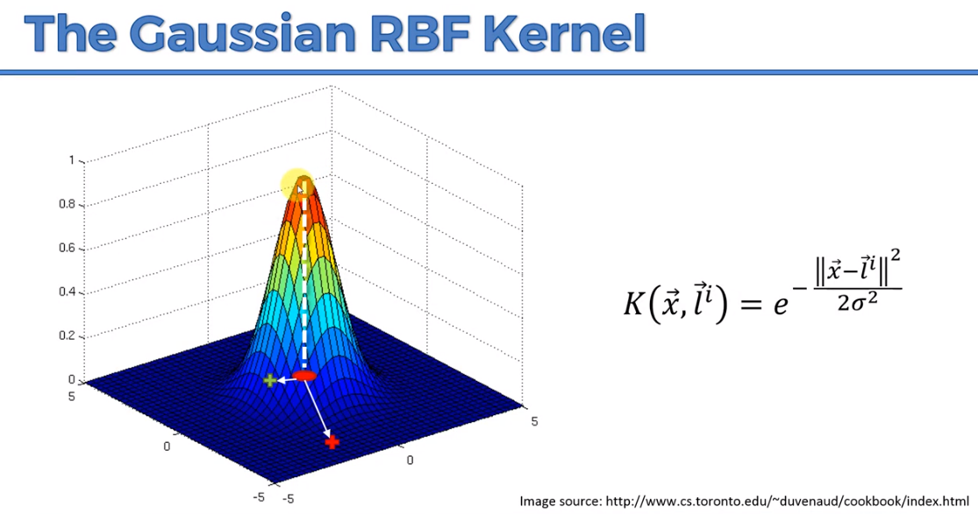
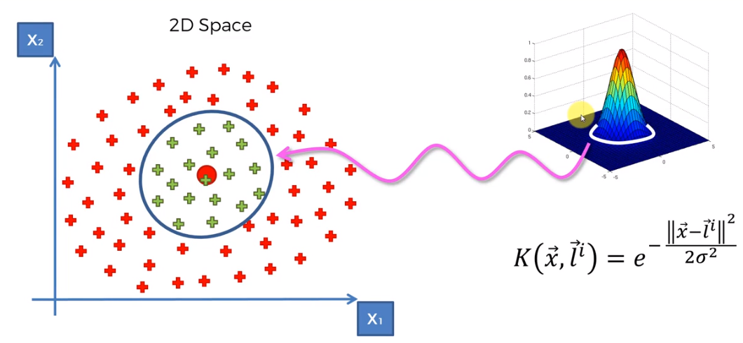
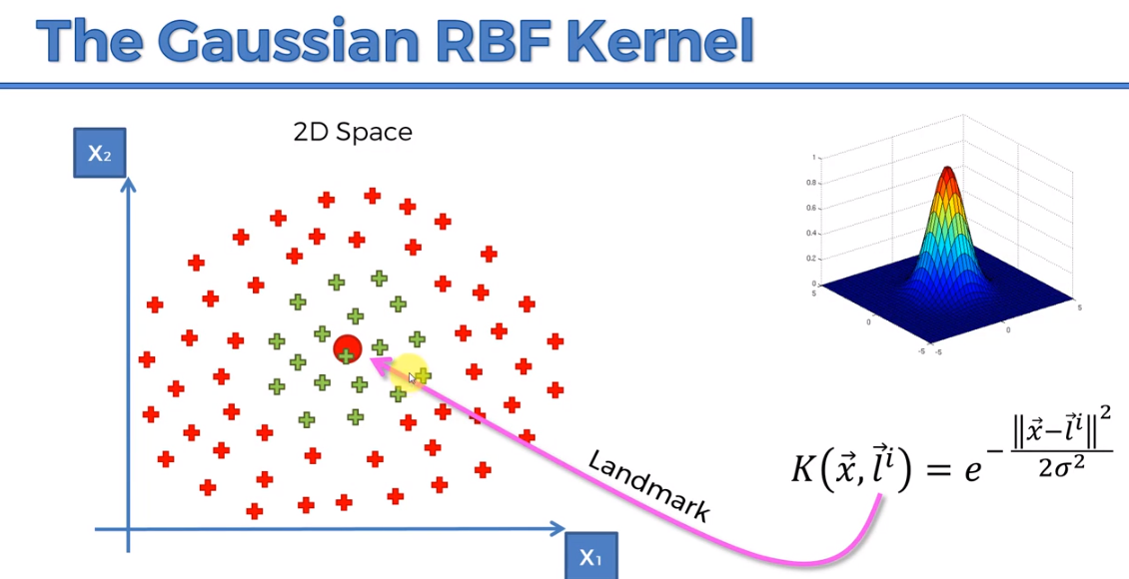
The Kernel trick!
Notes:
RBF = Radial Basis Function
If x is very far from the landmark, then K goes to zero.
Finding the landmark is a separate optimization problem.
By changing the sigma, you can change the classification boundary.
Note that this Kernel calculation is all done in 2 dimensions and not 3 dimensions.

Slide 7
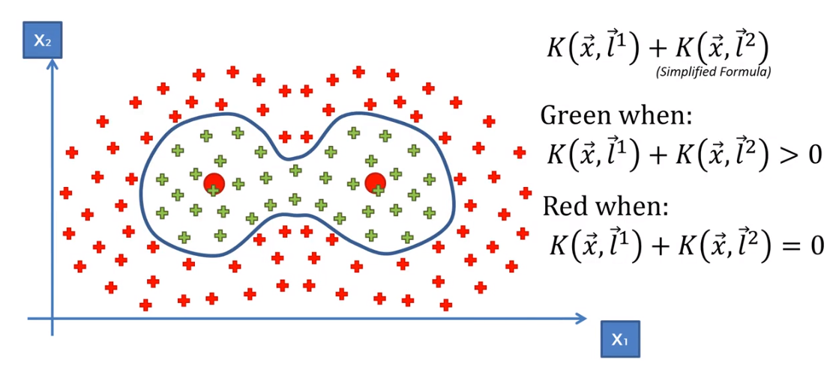
A more complex Kernel function.

Slide 8
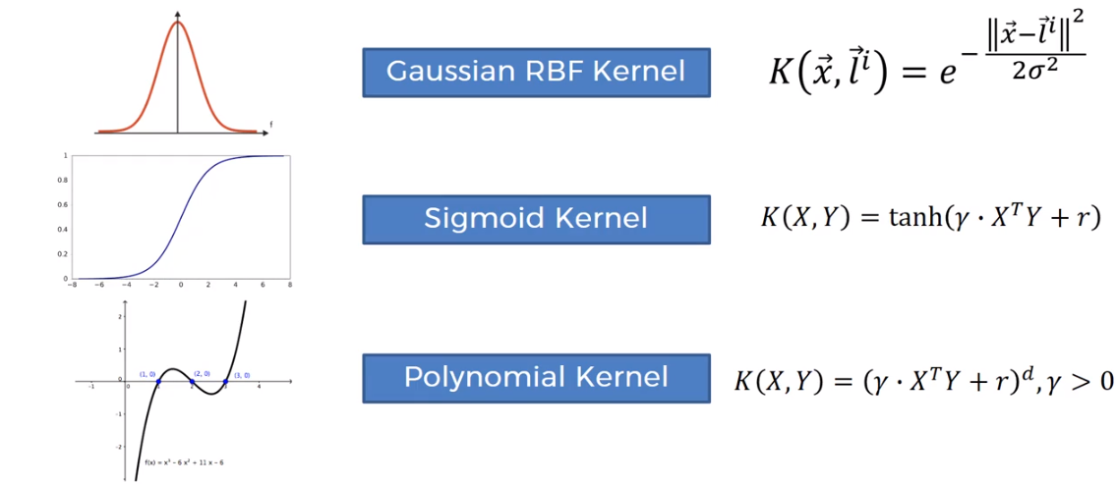
Types of Kernel Functions
Notes:
Tanh is the hyperbolic tangent function.

Slide 9
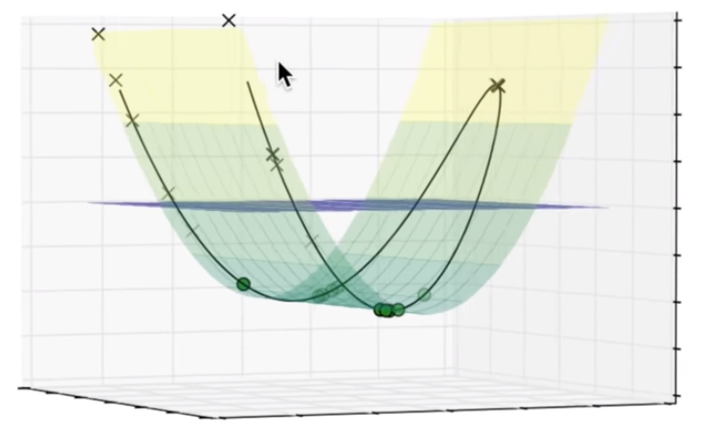
Visualization of SVM
Notes:
Starting video from 8:26 to 13:40
I really want you to go over this video entirely.

Slide 10
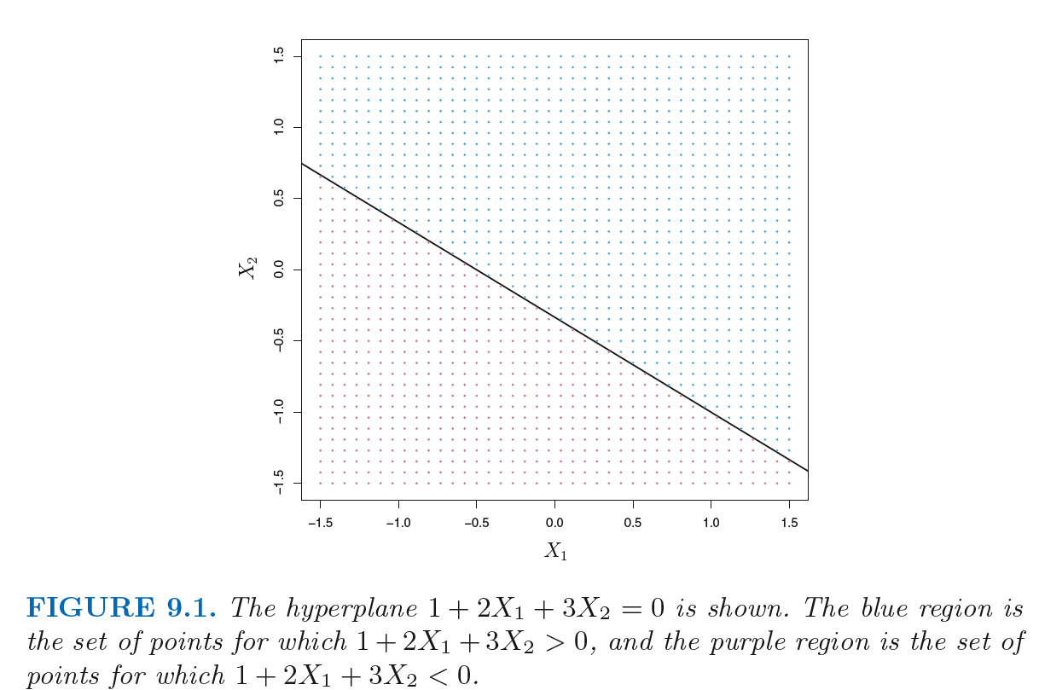
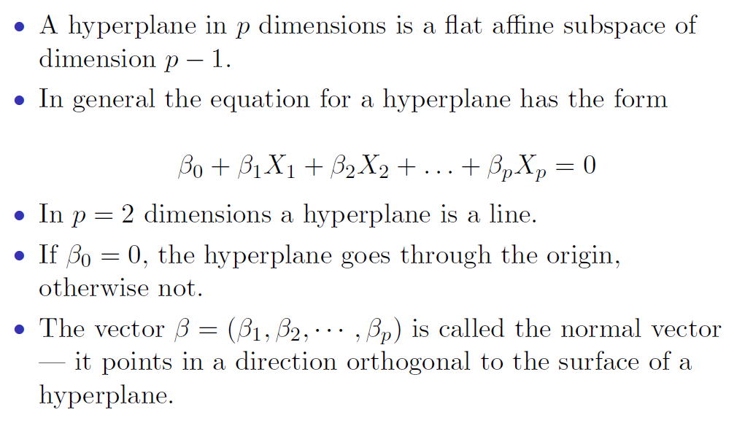
What is a Hyperplane?
Notes:
Examples of affine subspace: p=1 (single point), p=2 (line) and p=3 (plane) and etc.
Affine space: the elements are points (as opposed to vector space which the elements are vectors).
In affine space:
All points are equal (no special point). In Vector space we have an origin.

Slide 11
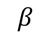
What is a Hyperplane?
$$β$$
Notes:
Examples of affine subspace: p=1 (single point), p=2 (line) and p=3 (plane) and etc.
Affine space: the elements are points (as opposed to vector space which the elements are vectors).
In affine space:
All points are equal (no special point). In Vector space we have an origin.

Slide 12
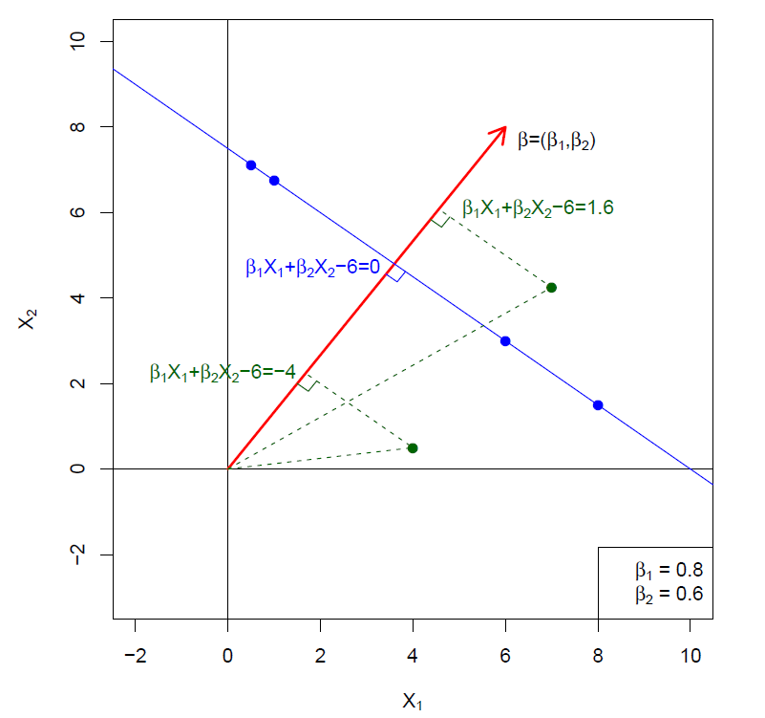
Hyperplane in 2 Dimensions
Perpendicular distance from the hyperplane
Notes:
1.6 and -4 are the distance from hyperplane.
All the points on a hyperplane are projected at the same point.
SS of betas are =1 so the direction vector beta is a unit vector. In this case the values (1.6 and etc) are the Euclidian distances from the hyper plane.
If beta is not unit vector (let’s say has length=2) then f(x) is twice the signed Euclidean distance from the separating hyperplane f(x) = 0. So it is important to add this restriction to our optimization problem that sum of squares of betas = 1
F(x)=1.6 means that that green point (6.5,4) is 1.6 units far from the blue line. Plug the numbers! The second point should be (2.5, 0) not (4,0.2)
It can be shown that if beta is unit vector then Euclidian distance of a point from the blue = | f(x) | / sqrt(SSB)
https://www.toppr.com/guides/maths/straight-lines/distance-of-point-from-a-line/

Slide 13
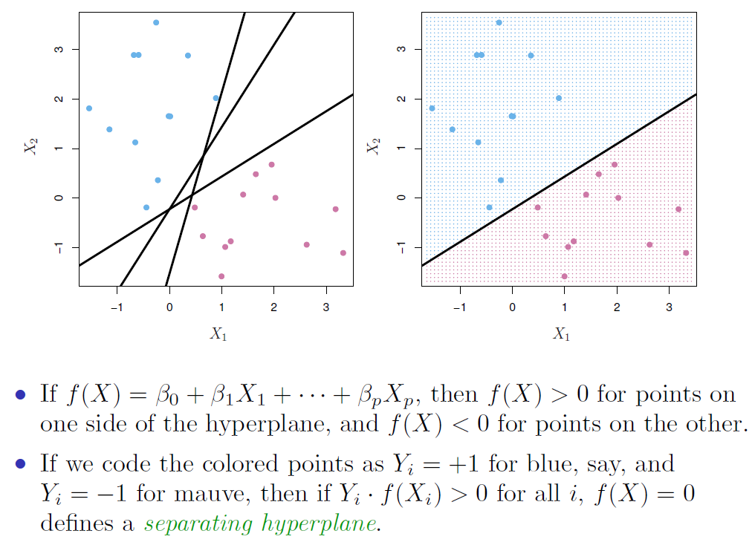
Separating Hyperplanes
Notes:
So we have many separating hyperplanes. Which one should we use?
We will choose the maximal margin classifier one. The one with the biggest gap or margin between the two classes.
Note that y.f(x) is always going to be positive. We will find betas st this thing is maxed. The distance from the separating hyperplane.

Slide 14
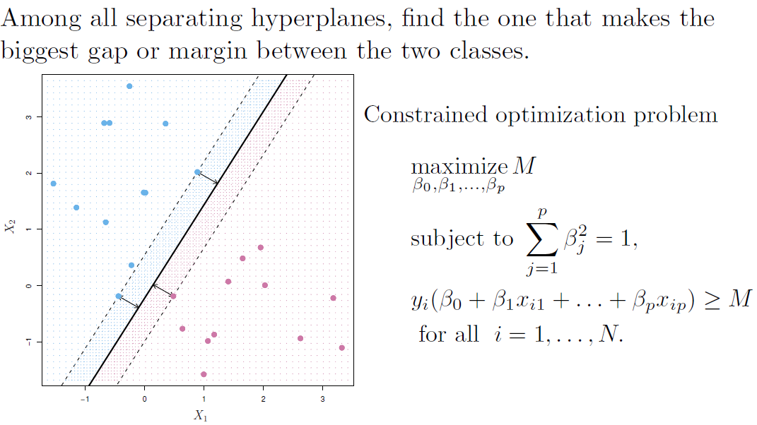
Maximal Margin Classifier
Notes:
Equidistance between blue and red points.
Why we look for biggest gap. Because if that’s the case in training set, we hope that it also applies to our test set. (even though it looks like overfitting but in practice in works fine)
M is just any number. We try to max it by solving for the betas.
Remember, y is -1 or 1. betas are found such that y.f(x) is maxed (>M)
What if data is not separable? (here is the power of SVM because we know that logistic regression or KNN cannot solve this)
In SVM it is very important to standardized our features first because SVM is treating all the features the same. Otherwise the Euclidian distance would be affected by larger scales features more.
All the points are required to find the support vector. But once the vector is found, it seems that only few of them are useful to draw the support vector. (common misunderstanding is that SVM is using very few observations). Later on we are going to see that these unused data in the SVM are actually getting weights of 0 (alpha=0) in the inner product representation of the SVM.

Slide 15
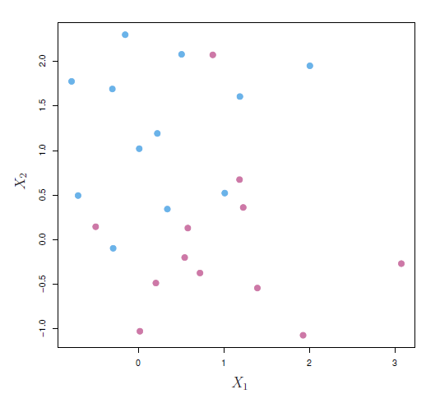
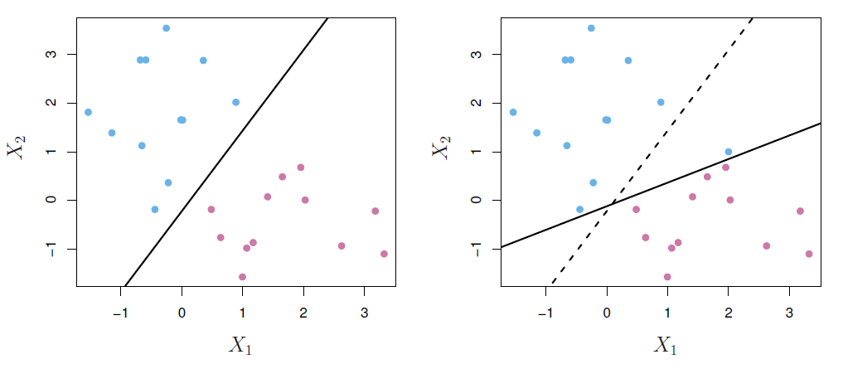
Common problems
Non-Separable data
Maximal margin classifier cannot be found
Noisy data
Maximal margin classifier is very sensitive to outliers
Notes:
We need to solve both of these problems

Slide 16
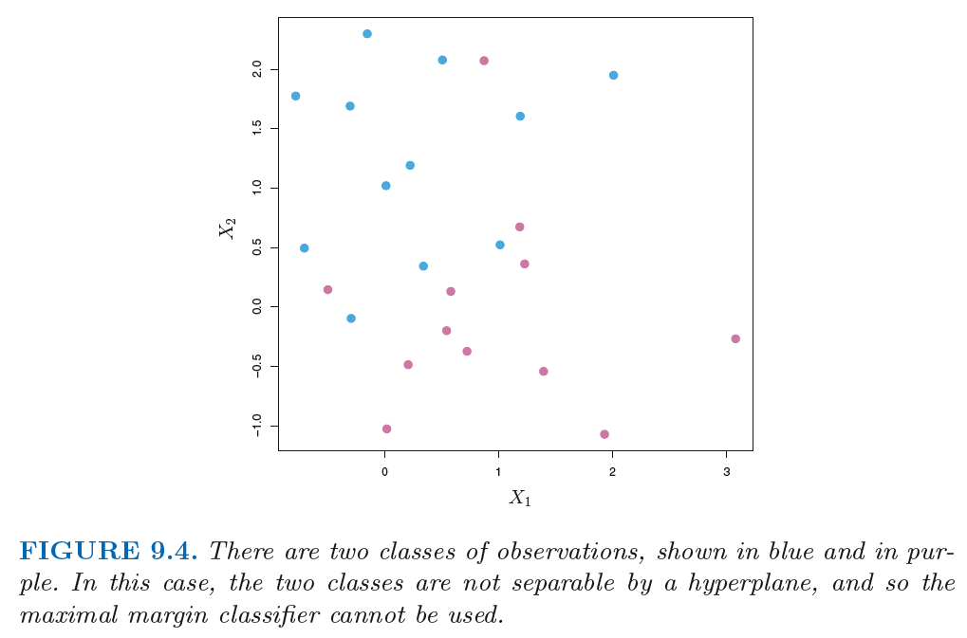
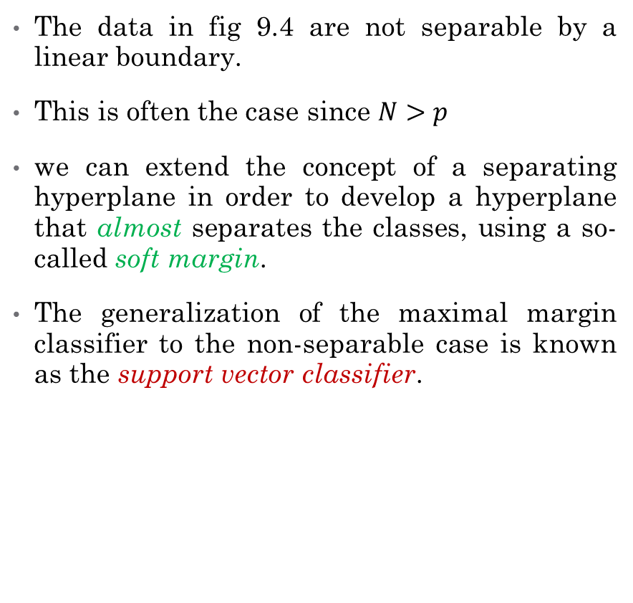
Non-Separable Data
The data in fig 9.4 are not separable by a linear boundary.
This is often the case since $N>p$
we can extend the concept of a separating hyperplane in order to develop a hyperplane that almost separates the classes, using a so-called soft margin.
The generalization of the maximal margin classifier to the non-separable case is known as the support vector classifier.

Slide 17
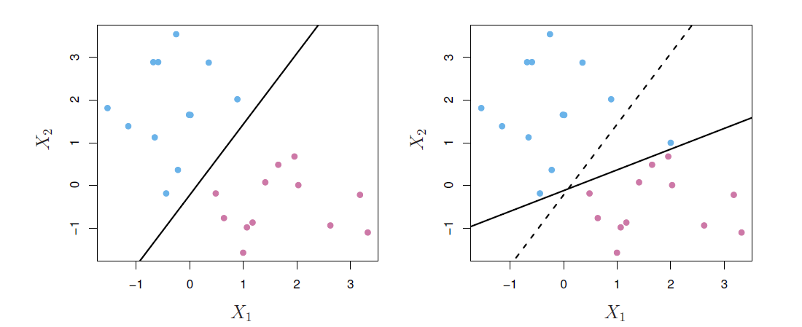
Noisy Data
In the case of noisy data, we might be willing to consider a classifier based on a hyperplane that does not perfectly separate the two classes, in the interest of:
Greater robustness to individual observations, and
Better classification of most of the training observations
That is, it could be worthwhile to misclassify a few training observations in order to do a better job in classifying the remaining observations.
The support vector classifier, sometimes called a soft margin classifier does exactly this.
Notes:
the fact that the maximal margin hyperplane is extremely sensitive to a change in a single observation suggests that it may have overfit the training data.
Rather than seeking the largest possible margin so that every observation is not only on the correct side of the hyperplane but also on the correct side of the margin, we instead allow some observations to be on the incorrect side of the margin, or even the incorrect side of the hyperplane. (The margin is soft because it can be violated by some of the training observations.)
An observation can be not only on the wrong side of the margin, but also on the wrong side of the hyperplane. In fact, when there is no separating hyperplane, such a situation is inevitable. Observations on the wrong side of the hyperplane correspond to training observations that are misclassified by the support vector classifier. The right-hand panel of Figure 9.6 illustrates such a scenario.

Slide 18
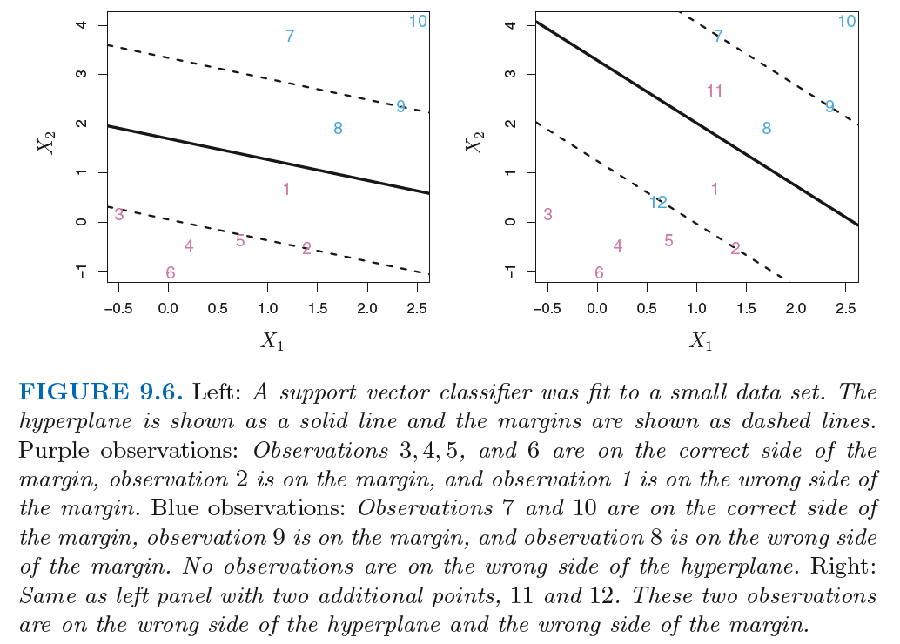
Support Vector Classifier
Notes:
We are going to relax the idea of a separating hyperplane to a soft margin. SVM is going to max the soft margin.
Bold lines are the decision boundaries and dashed lines are soft margins.
On the left, if I only look at 1 and 8, then what is the optimal hyperplane? (SVM will focus on the part of the data that there is not much red and blue data necessarily) so we make the margin wider (ignoring 1 and 8 and go to 9, 2,5,3). Now our 8 and 1 are going to be on the wrong side of the margin but we found a hyperplane that is determined by more than just the closest points (avoiding overfitting).
In the right panel it is essential to have a soft margin because we cannot find an optimal hyperplane otherwise. In this case there are couple of misclassifications thought (11 and 12)

Slide 19
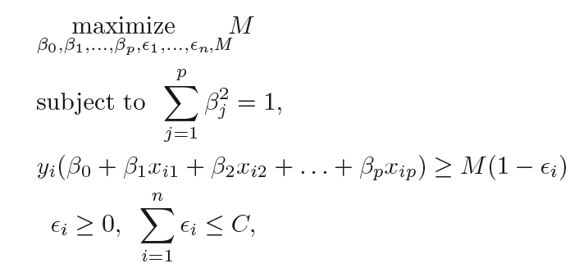
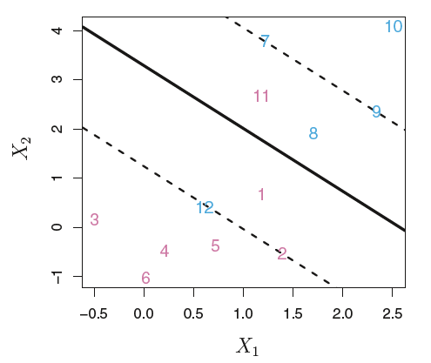
Support Vector Classifier
Notes:
M(1-error) means that we are going to max M st SSbeta=1 and the distance of all the points be bigger than M but discounted by (1-e) factor.
How do we restrict our slacks (errors)? By giving them a budget called C. Otherwise this margin could be very soft. The bigger the e, the wider the soft margin.
C is our tuning/regularization parameter that tunes the width of the soft margin.
Epsilons are slack variables that allow individual observations to be on the wrong side of the margin or the hyperplane.
If epsilon = 0 then the ith observation is on the correct side of the margin. If epsilon > 0 then the ith observation is on the wrong side of the margin, and we say that the ith observation has violated the margin. If epsilon > 1 then it is on the wrong side of the hyperplane.
This is another convex optimization problem solving for betas and epsilons (errors). We allow the model to max errors up to some budget C.
In max margin optimization, only the margin points are involved in finding the betas.
In max soft margin optimization, both points on and within the soft margin points will determine betas. Errors are distance from soft margins. Ex: distance from point 1 to lower margin is e1 and distance from point 8 to upper margin is e8.
Observations that lie directly on the margin, or on the wrong side of the margin for their class, are known as support vectors. These observations do affect the support vector classifier.

Slide 20
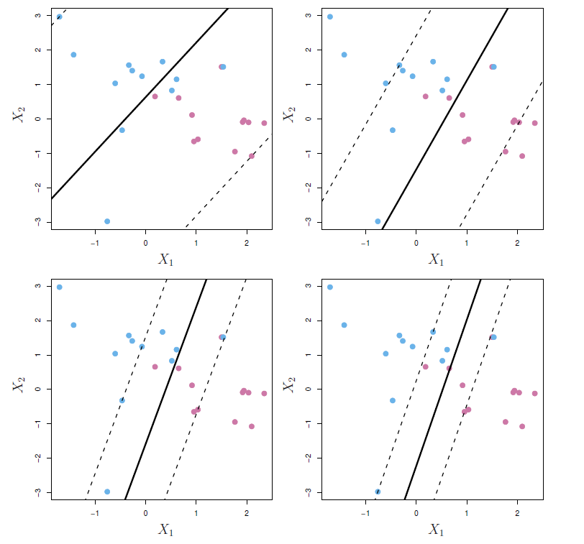
C is a tuning / regularization parameter
Notes:
We now consider the role of the tuning parameter C. In (9.15), C bounds the sum of the epsilons, and so it determines the number and severity of the violations to the margin (and to the hyperplane) that we will tolerate. We can think of C as a budget for the amount that the margin can be violated by the n observations.
If C = 0 then there is no budget for violations to the margin, and it must be the case that epsilon1 = . . . = n = 0, in which case this is the same as the maximal margin hyperplane optimization problem
For C > 0 no more than C observations can be on the wrong side of the hyperplane. As the budget C increases, we become more tolerant of violations to the margin, and so the margin will widen. Conversely, as C decreases, we become less tolerant of violations to the margin and so the margin narrows.
In practice, C is treated as a tuning parameter that is generally chosen via cross-validation
Top left is the biggest possible C, because all points are on the wrong side of the soft margin. Note that the dashed lines are using only two furthest points here. And the solid line is simply right in the middle.
As C gets bigger (more points in the soft margin), the margin gets more stable (the more points involved in the orientation of the margin). Bias variance trade off: the top left, the margin is most stable (smallest variance of beta and biggest bias) compare to the bottom right which is least stable (biggest variance but smallest bias). C increase = Se(beta) decrease
These points (within the margin) are the one controlling the orientation of the margin.
C controls the bias-variance trade-off of the statistical learning technique. When C is small, we seek narrow margins that are rarely violated; this amounts to a classifier that is highly fit to the data, which may have low bias but high variance. On the other hand, when C is larger, the margin is wider and we allow more violations to it; this amounts to fitting the data less hard and obtaining a classifier that is potentially more biased but may have lower variance
When the tuning parameter C is large, then the margin is wide, many observations violate the margin, and so there are many support vectors. In this case, many observations are involved in determining the hyperplane. The top left panel in Figure 9.7 illustrates this setting: this classifier has low variance (since many observations are support vectors) but potentially high bias. In contrast, if C is small, then there will be fewer support vectors and hence the resulting classifier will have low bias but high variance. The bottom right panel in Figure 9.7 illustrates this setting, with only eight support vectors.

Slide 21
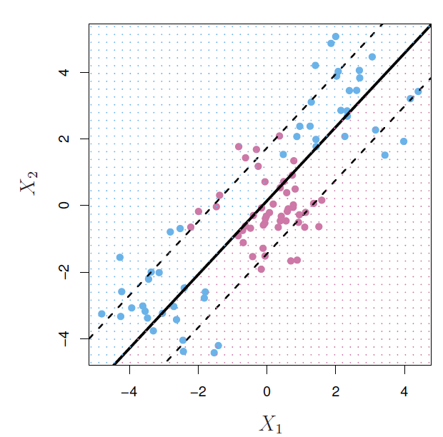
Failure of linear boundary
Sometime a linear boundary simply won't work, no matter what value of C.
What to do?
Feature expansion (Bend the margin!)
Notes:
Notice if we increase C, we still don’t have a good classifier. Misclassifications are many!

Slide 22
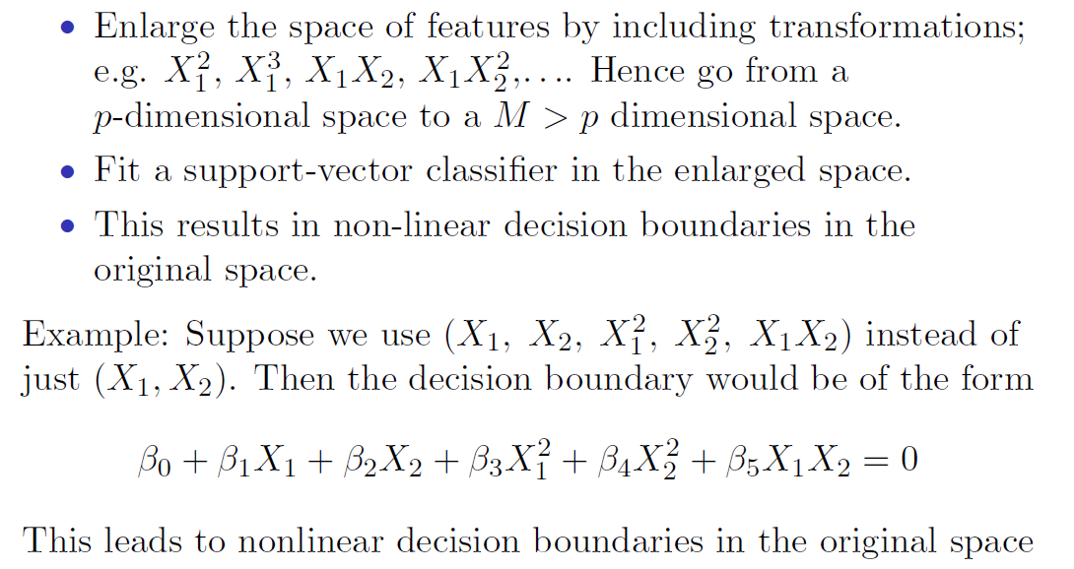
Feature Expansion
Notes:
This M is different from Margin M.

Slide 23
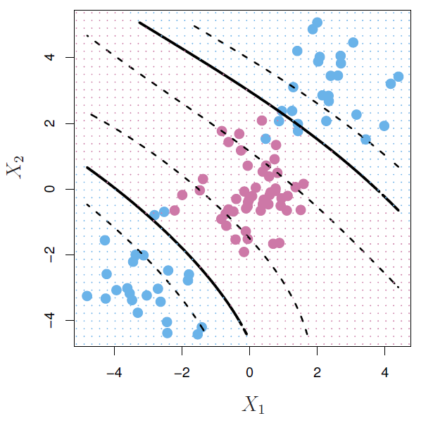
Heading
we use a basis expansion of cubic polynomials from 2 variables to 9.
The support-vector classifier in the enlarged space solves the problem in the lower-dimensional space
In a 9 dimension space, the decision boundary is a single linear boundary.
The projections in the 2 dimensional space are multiple non-linear boundaries
Notes:
Dashed lines are soft margins and solid ones are decision boundaries.
Think of 3 dimensions x1, x2 and z=x1x2. Here the hyperplane is a plane. Above that plane is class 1 and below it class 2. Now if we reduce the dimension to two, then two

Slide 24
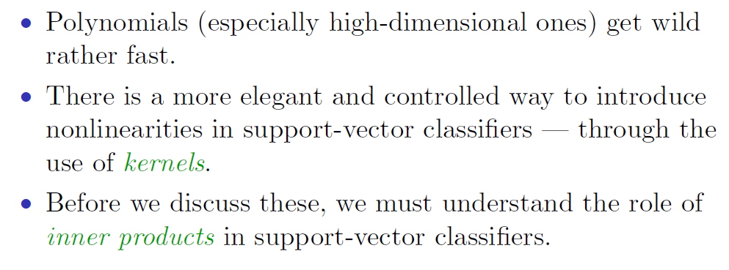
Nonlinearities and Kernels

Slide 25
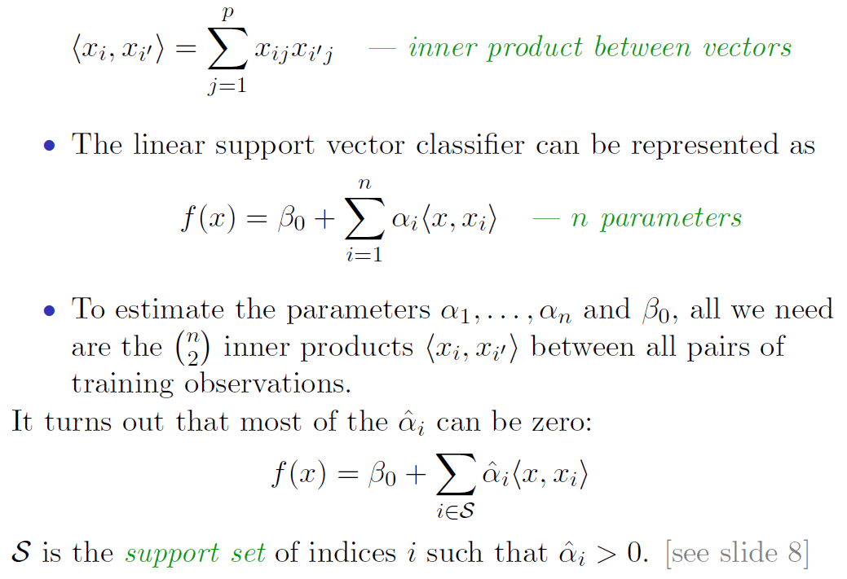
Inner products and support vectors
See slide 14
Notes:
Inner products: https://en.wikipedia.org/wiki/Inner_product_space
When we add a new test point and we want to classify it, we have to compute the all inner products between the train set and the new test point. Fit the SVM and evaluate the function. So this inner product method can be quite abstract.

Slide 26
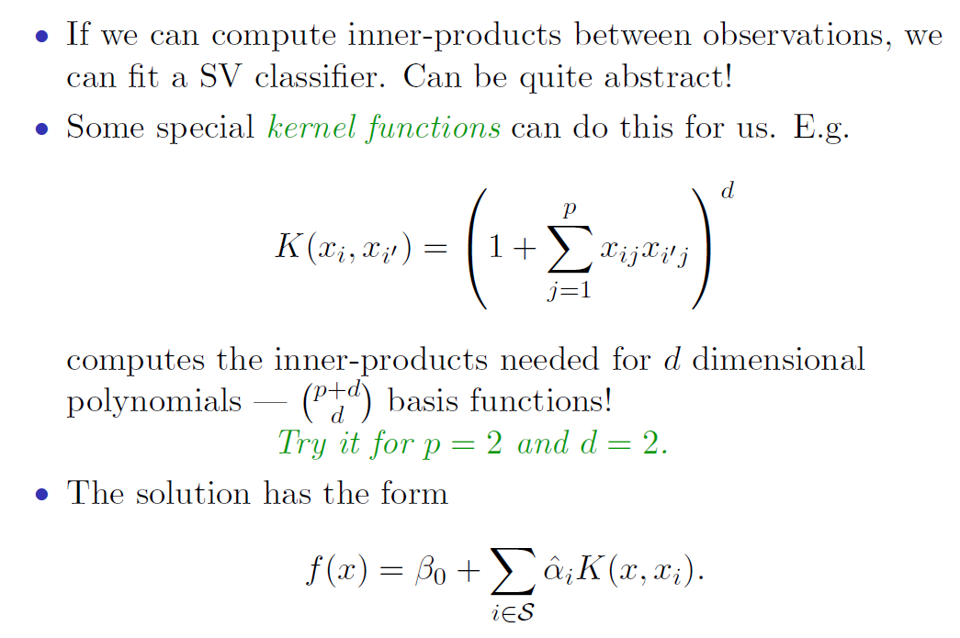
Kernels and Support Vector Machines

Slide 27
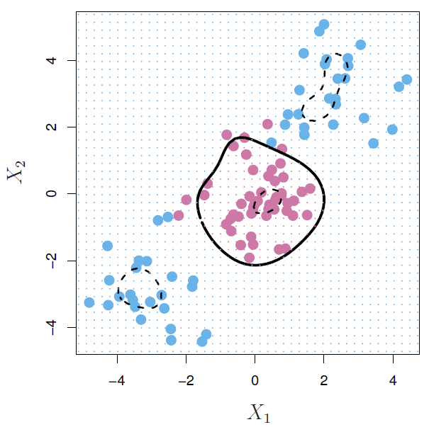
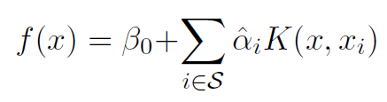
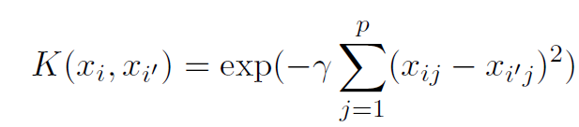
Radial Kernel
Radial Kernel, controls variance by squashing down most dimensions severely
Notes:
There are many different Kernels available. Radial Kernel is one of the most famous ones. The main part of it is coming from the multivariate Gaussian distribution. Gamma is the tuning parameter. This is an inner product in an abstract infinite dimensional feature space. Very high dimensional space that we can never visit it yet this Kernel computes the inner products first.
Kernels get around supper high dimensionality by squashing down most dimensions to zero.
The beauty of the "kernel trick" is that, even if there is an infinite-dimensional basis, we need only look at the n^2 inner products between training data points. So the computational effort required to solve a kernel support vector machine DOES NOT becomes greater and greater as the dimension of the basis increases.

Slide 28
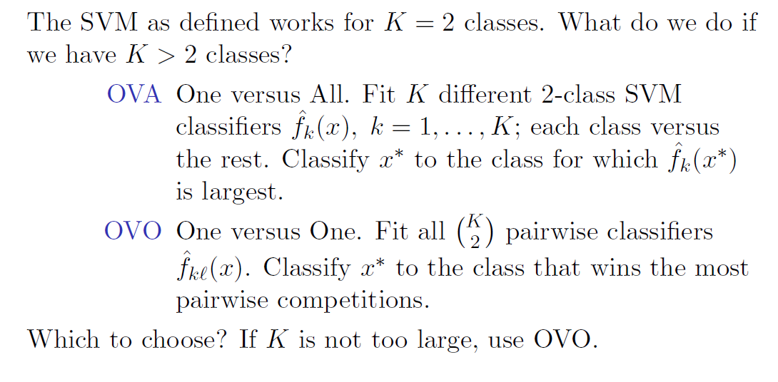
SVM for more than 2 classes!
Notes:
OVA: we have k of these f(x). We pick the one that is max i.e max marginal classifier.

Slide 29
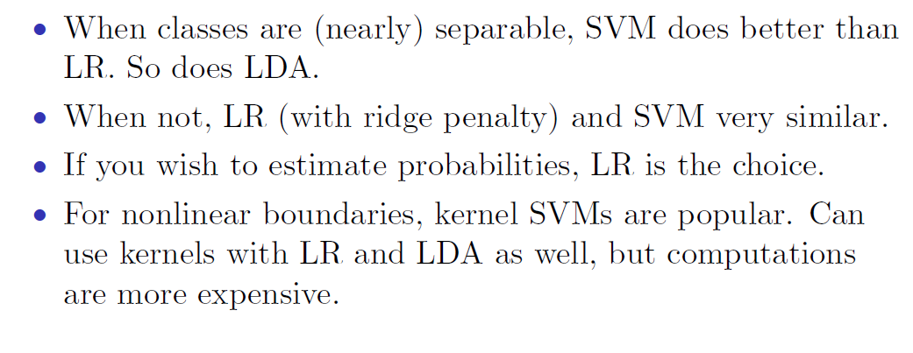
Which to use: SVM or Logistic Regression
Logistic Regression (LR)
Logistic Regression too,
Notes:
SVM is also not interpretable. Specially in high dimension problems.
SVM don’t give you probabilities which is a draw back. (51% and 99% are both classified as 1)

Slide 30
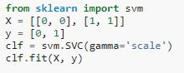
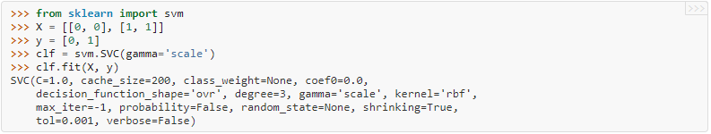
SVM in Python
Find the SVM Sklearn documentation here
Blackbox version of SVM in python:

